Slide 1
Paper Nine:
English Phonetics and Linguistics
Introduction
By
Dr. Prithiviraj Singh Chauhan

Slide 2
Learning objectives:
To develop fair understanding of language as system
To develop understanding of speech mechanism and sound system, classification of sound system
Understanding basics of linguistics and its various component
Understanding various methods of communication
To develop understanding Chomsky’s Transformational Generative Grammar, Halliday’s systemic linguistics
To develop understanding about variation in use of language

Slide 3
Learning Outcome: Phonetics
Students will be able explain the various organ of speech and their role in production of sound
Students will develop competency for categorization of sound on the basis of production into vowel and consonant
Students will develop competency to differentiate between different sound units and their role in formation of words
They will develop understanding of stress pattern and its role in determination of meaning of words
They will develop understanding about the interaction between language and cultural and how it affects our life

Slide 4
What is Phonetics
the science or study of speech sounds and their production, transmission, and reception, and their analysis, classification, and transcription. Compare acoustic phonetics, articulatory phonetics, auditory phonetics, physiological phonetics. ( https://www.dictionary.com/browse/phonetics)
Phonetics is study of human sound

Slide 5
Basics of Phonetics:
In phonetics we refer sounds i.e. phones
Sounds are the basic unit of language
Without sound We cannot communicate
Sounds are arranged systematically
Random arrangement of sound can destroy the quality of any language
Human body can produce number of sound but all the sounds cannot be part of language system

Slide 6
Mechanism of production of speech sound:
Most sounds are produced by an air stream from lungs through one or more speech organs.
Where and how obstructions are in the air stream determine the identity of the sound produced.
When the air pushed from inside to outside by lungs and the blockage created by organs of speech, produce friction which result is the production of sound.
Most of the language use pulmonic air stream mechanism ( Egressive: Pushing out, ingressive: inhaling)

Slide 7
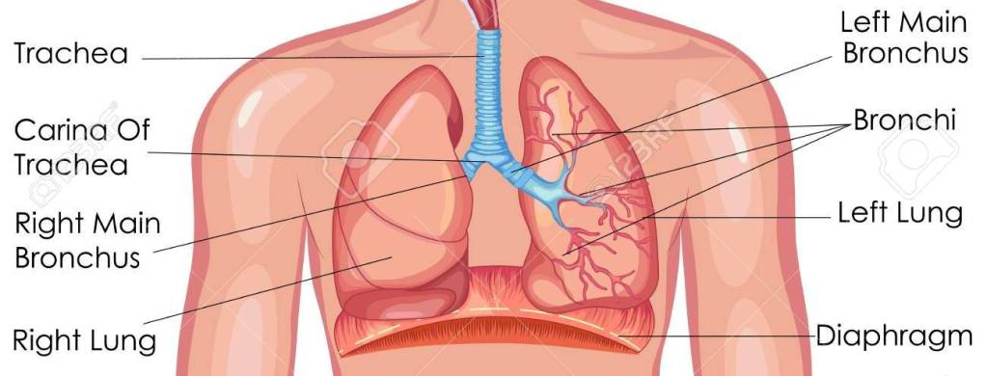
Respiratory System
PC: Internet

Slide 8
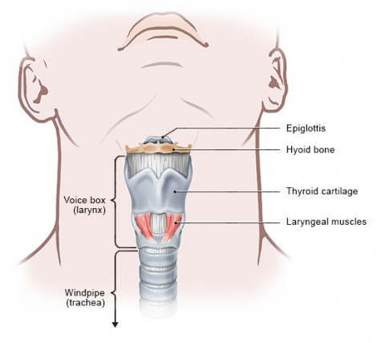
Phonatory System
https://www.informedhealth.org/how-does-the-larynx-work.3294.en.html

Slide 9
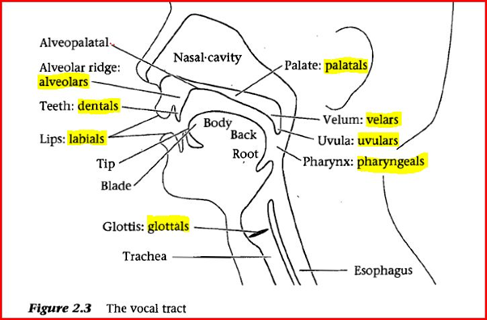
Conti..
http://ritongarasti.blogspot.com/2013/05/organ-of-speech-function-manner-and.html

Slide 10
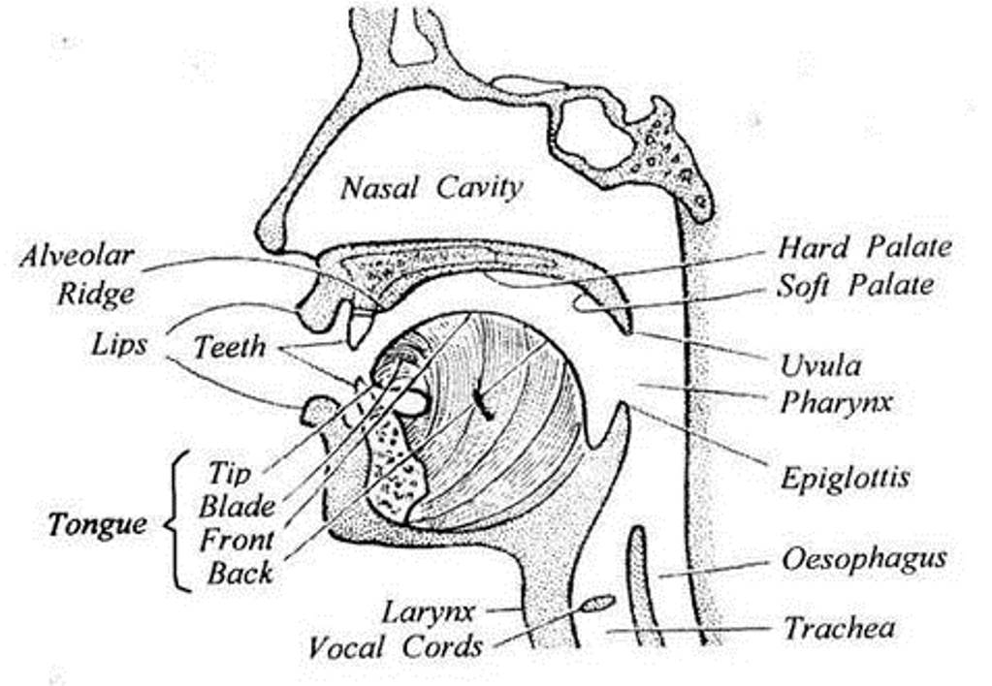
Articulatory System

